Slide 1
数据库原理与设计

Slide 2
本课程的目标
结合关系数据库系统深入理解数据库系统的基本概念，原理和方法。
■ 掌握关系数据模型及关系数据语言，能熟练应用SQL语言表达各种数据操作。
■ 掌握数据库设计的步骤和方法，通过对E-R模型的概念和方法、关系数据库规范化理论的学习及课程设计的训练，具备进行数据库应用系统设计与开发的能力。
■ 对数据库领域研究有大致了解，激发在此领域中继续学习和研究的愿望，为学习数据库系统高级课程做准备。
1-<number>
Notes:
为什么要学数据库

Slide 3
Chapter 1: Introduction 概论
本章内容特色
为全书内容铺底，广，浅
用山水画 写意手法 为全书做一个一个封面
远山淡抹，近水浓描
数据视图， 数据模型 ，DDL,DML ,
事务处理, 存储管理, 数据库管理,
数据库用户, 总体系统结构，
看远景，看轮廓，看全局。
不一定，全看懂，后面各章 会细细道来。

Slide 4
Introduction to Database
CHAPTER 1
INTRODUCTION
Database-System Applications
Purpose of Database Systems
View of Data
Database Languages
Relational Databases
Database Design
Data Storage and Querying
Transaction Management
Database Architecture
Database Users and Administrators
1-<number>

Slide 5
Database System: Introduction
Database Management System (DBMS)
  Collection of interrelated data (database)
  Set of programs to access the data
Goal of a DBMS:
  provides a way to store and retrieve database information that is both
    convenient and
    efficient.
Functions of DBMS: Management of Data (MOD)
  Defining structure for storage data
  Providing mechanisms for manipulation of data
  Ensure safety of data (system crashes, unauthorized access, misused, …)
  Concurrent control in multi-user environment
Computer Scientists: developed a lot of concepts and technique for MOD
  concepts and technique form the focus of this book, and this course
1-<number>

Slide 6
1.1 Database-System Applications
Database Applications:
  Banking: all transactions
  Airlines: reservations, schedules
  Universities: registration, grades, student profile, ..
  Sales: customers, products, purchases
  Manufacturing: production, inventory, orders, supply chain
  Human resources: employee records, salaries, tax deductions
Databases touch all aspects of our lives
1-<number>

Slide 7
1.2 Purpose of Database Systems
In the early days, database applications were built on top of file systems
Drawbacks of using file systems to store data:
  Data redundancy and inconsistency （数据冗余和不一致性）
    Multiple file formats, duplication of information in different files
  Difficulty in accessing data （数据存取困难）
    Need to write a new program to carry out each new task
  Data isolation — multiple files and formats （数据孤立）
  Integrity problems （完整性问题）
    Integrity constraints (e.g. account balance > 0) become part of program code
    Hard to add new constraints or change existing ones
1-<number>
Notes:
新约束，补考成绩60；主键约束 外键约束 用户定义约束

Slide 8
Drawbacks of using file systems (cont.)
Drawbacks of using file systems to store data: (cont.)
  Atomicity of updates （原子性问题）
    Failures may leave database in an inconsistent state with partial updates carried out
    E.g. transfer of funds from one account to another should either complete or not happen at all
  Concurrent access by multiple users(并发访问问题)
    Concurrent accessed needed for performance
    Uncontrolled concurrent accesses can lead to inconsistencies
      E.g. two people reading a balance and updating it at the same time
  Security problems（安全性问题）
Database systems offer solutions to all the above problems
Solution
1-<number>

Slide 9
1.3 View of Data and Data Abstraction
Physical level: describes how a record (e.g., customer information) is stored in disk.
  By sequential file, pointer, or hash structure, …
Logical level: describes data stored in database, and the relationships among the data.
type customer = record
name : string;
street : string;
city : string;
income : integer;
end;
View level: application programs hide details of data types. Views can also hide information (e.g., income) for security purposes.
1-<number>
Notes:
******

Slide 10
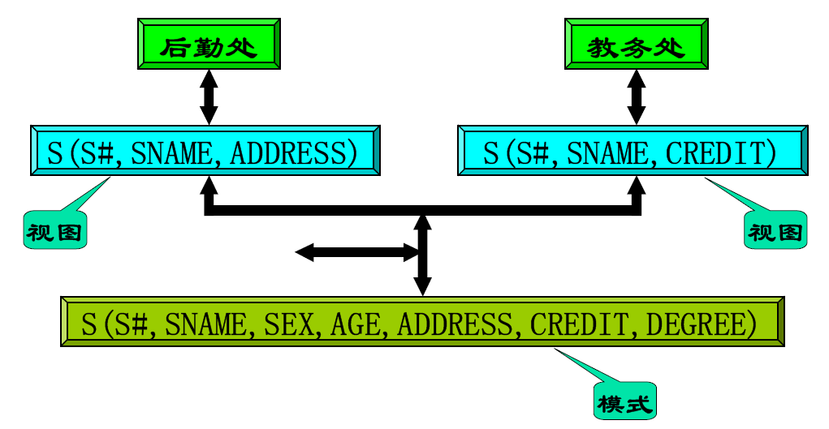
1-<number>

Slide 11
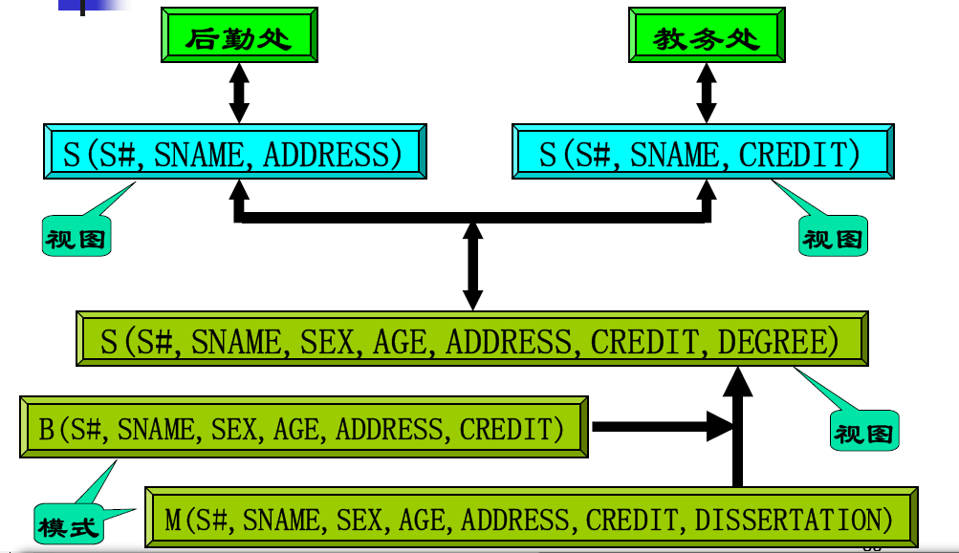
1-<number>

Slide 12
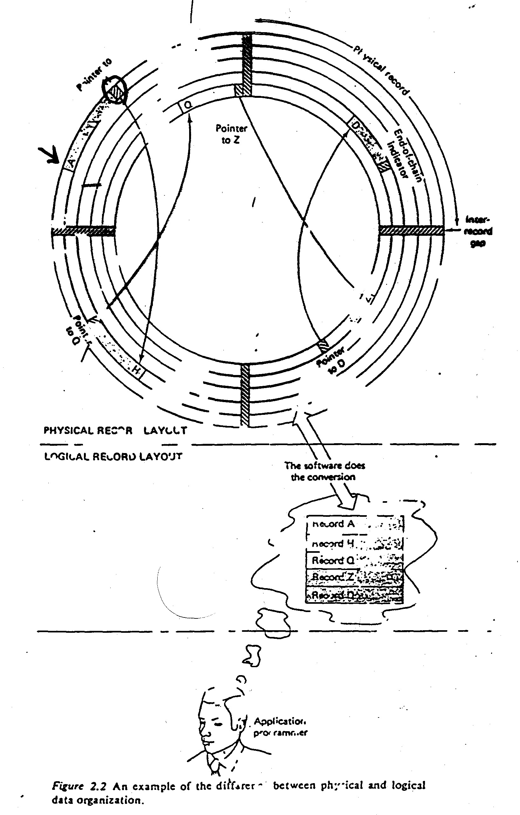

View of Data -1: Three Levels
An architecture for a database system
1-<number>

Slide 13
1.3.2 Instances 实例and Schemas模式
Schema – the logical structure of the database, the design of the database
  e.g., the database consists of information about a set of customers and accounts and the relationship between them
  Analogous to type information of a variable in a program
  Physical schema: database design at the physical level
  Logical schema: database design at the logical level
account
  create table account
  (account-number char(10),
  balance integer)
type customer = record
name : string;
street : string;
city : integer;
end;
customer
1-<number>
Notes:
Type 定义数据类型
VAR c1 customer;

Slide 14

Instances and Schemas (cont.)
Instance – the actual content of the database at a particular point in time
  Analogous to the value of a variable
Physical Data Independence – the ability to modify the physical schema without changing the logical schema
  Applications depend on the logical schema
  In general, the interfaces between the various levels and components should be well defined so that changes in some parts do not seriously influence others.
Instance
Schema
  create table account
  (account-number char(10),
  balance integer)
1-<number>
Notes:
软件模块的例子，接口要很好定义

Slide 15
View of Data: Three Levels
An architecture for a database system
Physical Data Independence
1-<number>

Slide 16
1.3.3 Data Models数据模型
数据模型是对现实世界进行数据抽象的结果
  是一个描述数据、数据联系、数据语义以及一致性约束的概念工具的集合。
数据抽象可以分级进行
  一级→ 概念模型（实体-联系、ODL）
  按用户的观点来对数据和信息建模
  二级→ 逻辑模型（关系、网状、层次、面向对象、对象关系、半结构化等）
  从计算机实现的观点来对数据建模
1-<number>

Slide 17
Category of Data Models
Category of Data Models:
  Entity-Relationship model
  Relational model
  Object-oriented model
  Semi-structured data models
    Extensible Markup Language (XML)
  Older models:
    Network model and
    Hierarchical model
1-<number>

Slide 18
1.4 Database Languages
Data Definition Language (DDL):
  Specification notation for defining the database schema
  E.g.
  create table account
  (account-number char(10),
  balance integer)
Data Manipulation Language (DML)
  To express database queries or updates
  E.g.
  Select account-number
  from account
  where balance >1000
SQL (Structured Query Language): a single language for both
1-<number>

Slide 19
1.4.1 Data-Manipulation Language (DML)
Language for accessing and manipulating the data organized by the appropriate data model
  DML also known as query language
  For retrieval, insertion, deletion, modification (update)
Two classes of languages
  Procedural DMLs – user specifies what data is required and how to get those data
    E.g. … in C
  Declarative DMLs (Nonprocedural DMLs) – user specifies what data is required without specifying how to get those data
    E.g. In SQL: Select account-number
    from account
    where balance > 700
SQL is the most widely used query language
1-<number>
Notes:
使用过程化DML时，需要告诉系统需要什么数据，如何获取这些数据
过程化DML常被嵌入到高级程序语言中
网状和层次DML是过程化的

Slide 20
1.4.2 Data-Definition Language (DDL)
Specification notation for defining the database schema
  E.g.
  create table account
  (account-number char(10),
  balance integer)
  Define:
    Attributes name
    Data type
    Consistency constraints (integrity constraints)
      Domain constraints:
      e.g. assets are integer type
      Assertions: e.g. assets >= 0
      Authorization: for different users
      参照完整性….
create table branch
(branch-name char(15),
branch-city char(30),
assets integer,
primary key (branch-name),
check (assets >= 0))
1-<number>

Slide 21
1.5 Relational Databases
  Definition 1: A Relational Database is a database that is perceived by the users as a collection of time-varying, normalized relations (tables).
    Perceived by the users: the relational model apply at the view level and logical levels.
    Time-varying: the set of tuples changes with time.
    Normalized: contains no repeating group (only contains atomic value).
  The relational model represents a database system at a level of abstraction that removed from the details of the underlying machine, like high-level language.
C, PASCAL ,PL/1
DBMS environments
assembler
Relational DBMS
machine
Relational
Data Model
1-<number>

Slide 22
1.5.1 Tables
Definition 2: A Relational Database is a database that is perceived by its users as a collection of tables (and nothing but tables).
1-<number>

Slide 23
1.5.2 Data-Manipulation Language
SQL (Structured Query Language) : widely used
  E.g. find the name of the customer with customer-id 192-83-7465
  select customer.customer-name
  from customer
  where customer.customer-id = ‘192-83-7465’
customer
Output:
customer-name
Johnson
1-<number>

Slide 24
SQL (Structured Query Language)
  E.g. find the balances of all accounts held by the customer with customer-id 192-83-7465
  select account.balance
  from depositor, account
  where depositor.customer-id = ‘192-83-7465’ and
  depositor.account-number = account.account-number
1-<number>

Slide 25
1.5.3 Data-Definition Language
SQL provides DDL to define database schema:
  Tables
    E.g.
    create table account
    (account-number char(10),
    balance integer)
  Assertions (ref. p.132)
    E.g. create assertion balance-constraint
    check account.balance >= 1000
  integrity Constraints (ref. p.129)
1-<number>

Slide 26


Referential Integrity Constraint
3. account
create table account
(account-number char(10),
branch-name char(15),
balance integer,
primary key (account-number),
create table depositor
(customer-name char(20),
account-number char(10),
primary key (customer-name, account-number),
foreign key (account-number) references account,
存款帳
references
4. depositor
存款戶
1-<number>

Slide 27

1.5.4 Data Access from Application Programs
Application programs generally access databases through one of
  Language extensions to allow embedded SQL
  Application program interface (e.g. ODBC/JDBC) which allow SQL queries to be sent to a database
  ODBC: Open Database Connectivity for C
  JDBC: Java Database Connectivity for Java language
ODBC/JDBC
1-<number>
Notes:
EXEC SQL BEGIN DECLARE SECTION;
EXEC SQL CONNECT TO SQLServer.DataBaseName USER logName.passwd
EXEC SQL select EmployeeID INTO :EmployeeID from orders
where OrderID = 345
EXEC SQL DISCONNECT ALL;
EXEC SQL END DECLARE SECTION;

Slide 28
1.6 Database Design
Database Design - The process of designing the general structure of the database:
  Logical Design
  Physical Design
Logical Design – Deciding on the database schema.
  To find a “good” collection of relation schemas.
  Business decision – What attributes should we record in the database?
  Computer Science decision – What relation schemas should we have and how should the attributes be distributed among the various relation schemas?
Physical Design – Deciding on the physical layout of the database
1-<number>
Notes:
设计

Slide 29
1.6 Database Design
Requirement Analysis（需求分析） –Characterize fully the data needs of the prospective database users
Logical Design（逻辑设计）– Deciding on the database schema. Database design requires that we find a “good” collection of relation schemas.
  Business decision – What attributes should we record in the database?
  Computer Science decision – What relation schemas should we have and how should the attributes be distributed among the various relation schemas?
Physical Design（物理设计） – Deciding on the physical layout of the database

Slide 30

1.6 Database Design
1.6.3 The Entity-Relationship Model
Models an enterprise as a collection of entities and relationships
  Entity（实体）: a “thing” or “object” in the enterprise that is distinguishable from other objects
    Described by a set of attributes
  Relationship（关系）: an association among several entities
Represented diagrammatically by an entity-relationship diagram:

Slide 31
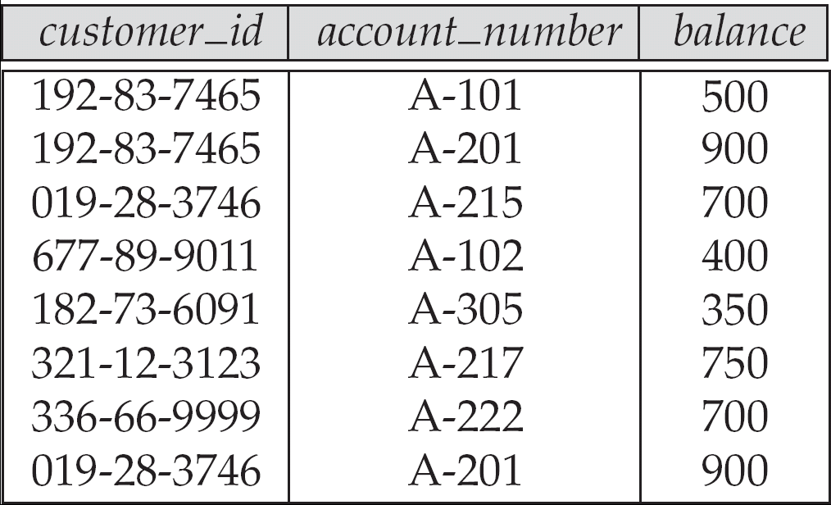
1.6 Database Design
1.6.4 Normalization
The mainly method to design a good relational database
  Normal Form（范式）: the definition on level of DB to be a standard relational database.
  Functional dependencies（函数依赖）: ？？？
Represented diagrammatically by an entity-relationship diagram:

Slide 32
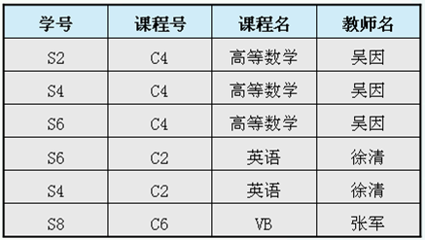
例：设有一个关系模式
教学（学号，课程号，课程名，教师名）
很显然，该关系模式的码为（学号，课程号），所以在每个元组上，学号和课程号的值均不能为空值。

Slide 33
虽然这个模式只有4个属性，但在使用过程中会出现以下几个问题：
数据冗余。如果一门课程有多个学生选修那么这门课程的课程名和任课老师姓名也要重复多次
操作异常。由于数据的冗余在对数据操作时引起各种异常：
  修改异常。如要修改某课程的任课教师，而该课程由多人选修的话，都要逐个修改。若有一个元组的教师姓名未改，就会造成数据不一致现象。
  插入异常。插入尚无学生选修的课程时，“学号”为空值
  删除异常。在前表中如果删除学生S8的选课元组，那么就要把‘VB’这门课程和教师姓名也删除了。这也是一种不合适的现象。
因此，关系模式‘教学’的设计不是一个合适的设计。

Slide 34
1.8 Data Storage and Querying
Components of Database System
  Query Processor
    Helps to simplify to access data
    High-level view
    Users are not be burdened unnecessarily with the physical details
  Storage Manager
    Require a large amount of space
    Can not store in main memory
    Disk speed is slower
    Minimize the need to move data between disk and main memory
Query
DBMS
Language Processor
Optimizer
Query Processor
Operation Processor
Access Method
Storage Manager
File Manager
Goal of a DBMS: provides a way to store and retrieve data that is both convenient and efficient.
Database
1-<number>

Slide 35

Overall System Structure
查询处理
Overall System Structure
存储管理
low-level data stored
database
1-<number>

Slide 36
1.8.1 Storage Management
Storage Manager
  is a program module
  that provides the interface between the low-level data stored and the application programs and queries submitted to the system.
Tasks of the Storage Manager:
  interaction with the file manager (part of Operating System)
  Translates DML into low-level file-system commands,
  i.e. responsible for storing存储, retrieving 检索and updating更新 of data in database
Data Structures of the Storage Manager
  Data files: store database itself
  Data Dictionary: store metadata
  Indices: provide fast access to data items that hold particular values
1-<number>

Slide 37
Storage Management (cont.)
Components of Storage manager:
  Authorization and Integrity完整性 Manager
    Tests for the satisfaction of integrity constraints
    Checks the authority of users to access data
  Transaction Manager
    Ensure the database in a consistent state (correct) after failures
    Ensure that concurrent transaction executions proceed without conflicting
  File Manager
    Manages the allocation of space on disk
    Manages the data structures used to representation data stored
  Buffer manager
    Fetches data from disk into main memory
    Decides what data to cache in main memory
1-<number>

Slide 38
1.8.2 The Query Processor
DDL Interpreter
  Interprets DDL statements
  write the definitions (schema, view, ..) into the data dictionary数据字典
DML Compiler
  Translates DML statements into an evaluation plan计算方案 (or some evaluation plans) which consists low-level instructions
  Query Optimization查询优化: picks the lowest cost evaluation plan
Query Evaluation Engine:
  execute low-level instructions generated by the DML Compiler
1-<number>
Notes:
Select * from student where sno sage sdept, 执行方案不一

Slide 39
1.9 Transaction Management
Transaction:
  A transaction is a collection of operations that performs a single logical function in a database application
  Atomicity: all or nothing
Failure recovery manager
  ensures that the database remains in a consistent (correct) state,
  Failure:
    system failures (e.g., power failures and operating system crashes)
    transaction failures.
Concurrency-control manager
  controls the interaction among the concurrent transactions, to ensure the consistency of the database.
1-<number>

Slide 40
1.10 Data Mining and Analysis
Data Analysis and Mining
  Decision Support Systems
  Data Analysis and OLAP (Online analytical processing),
  Data Warehousing
  Data Mining
1-<number>

Slide 41
Decision Support Systems
Decision-support systems
  are used to make business decisions,
  often based on data collected by on-line transaction systems.
Examples of business decisions:
  What items to stock?
  What insurance premium to change?
  To whom to send advertisements?
Examples of data used for making decisions
  Retail sales transaction details
  Customer profiles (income, age, gender, etc.)
1-<number>

Slide 42
Data Mining (ch.18)
Data mining:
  seeks to discover knowledge automatically in the form of statistical rules and patterns from large databases. E.g. p.23: Young women buy cars.
  is the process of semi-automatically analyzing large databases to find useful patterns
Prediction based on past history
  Predict if a credit card applicant poses a good credit risk, based on some attributes (income, job type, age, ..) and past history
  Predict if a pattern of phone calling card usage is likely to be fraudulent
Descriptive Patterns
  Associations
    Find books that are often bought by “similar” customers. If a new such customer buys one such book, suggest the others too. (library)
  Associations may be used as a first step in detecting causation
欺騙的
引起;因果關係
1-<number>

Slide 43
1.11 Database Architecture
System Structure of a Database System
  Fig. 1.6 (p.25)
Application Structure
  User uses database at the site
  Users uses database through a network
    Client: remote database users work
    Sever: database system runs here
Partition of Database Application
  Two-tier architecture
  Three-tier architecture
1-<number>

Slide 44
Application Architectures
ODBC/JDBC
Two-tier Architecture: e.g. client programs using ODBC/JDBC to communicate with a database
Three-tier Architecture: e.g. web-based applications, and applications built using “middleware”
1-<number>

Slide 45
1.12.1 Database Users and User Interfaces
Application programmers
  interact with system through DML calls
Sophisticated users
  Submit query without write program
  E.g. OLAP (Online analytical processing), data mining tools
Naive users (end user)
  invoke one of the permanent application programs that have been written previously
  E.g. people accessing database over the web, bank tellers, clerical staff
複雜, 多用途
單純的
辦事員
1-<number>

Slide 46
1.12.2 Database Administrator
Database Administrator:
  Coordinates all the activities of the database system;
  has a good understanding of the enterprise’s information resources and needs.
Database Administrator's Duties:
  Schema definition
  Storage structure and access method definition
  Schema and physical organization modification
  Granting of authorization for data access
  Routine maintenance
    Periodically backup database
    Upgrade system e.g. disk
    Monitoring performance
  …
1-<number>

Slide 47
1.13 History of Database Systems
1950s – early 1960:
  Tapes: sequentially
  Application: Payroll,
  Input: punched decks, Output: printer
Late 1960s -- 1970s:
  Disk: direct access
  Codd proposed Relational Model, … ➔ Turing Award
1980s:
  System R: IBM Res. Lab. ➔ IBM DB2, Oracle, Ingress, DEC Rdb
  Replaced Network/Hierarchical model
  Research: parallel database, distributed database, object-oriented, …
Early 1990s:
  Parallel database
  Object-Relational
Late 1990s:
  World Wide Web was explosive growth
  Database were used much more than ever before
  Database had to support Web interfaces to data
1-<number>
Notes:
24*7 高并发

Slide 48
End of Chapter 1

